Slide 1
SOLID & Design Pattern

Slide 2
What is SOLID Principle
A set of golden rules
Aim to
Improve the design and maintainability of software
Help create flexible, scalable, and easy to modify code.
Reduce costs and improve the long-term sustainability of software projects.

Slide 3
Why?
Improved maintainability
Reduced complexity
Enhanced flexibility
Increased scalability

Slide 4
The 5 principles of SOLID
Single-responsibility principle
Open-closed principle
Liskov substitution principle
Interface segregation principle
Dependency inversion principle

Slide 5
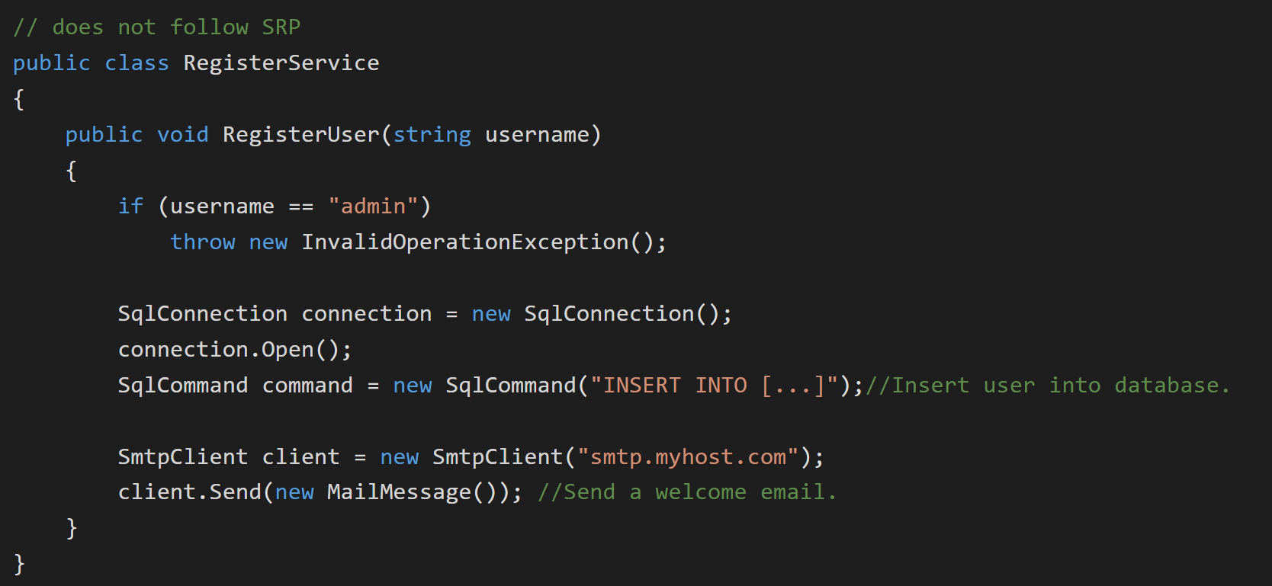
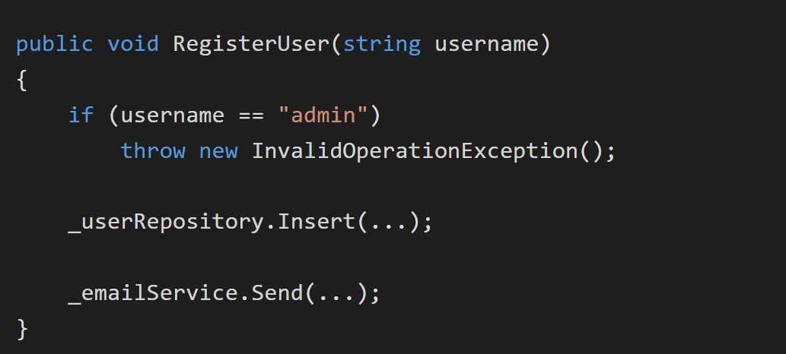
S: Single-responsibility principle
A class should only have a single responsibility, that is, only changes to one part of the software’s specification should be able to affect the specification of the class

Slide 6
O: Open-closed principle
Software entities … should be open for extension, but closed for modification
Software entities … should be open for extension, but closed for modification.
// Does not follow OCP
public double Area(object[] shapes)
{
double area = 0;
foreach (var shape in shapes)
{
if (shape is Rectangle)
{
Rectangle rectangle = (Rectangle) shape;
area += rectangle.Width*rectangle.Height;
}
else
{
Circle circle = (Circle)shape;
area += circle.Radius * circle.Radius * Math.PI;
}
}
return area;
}
public class AreaCalculator
{
public double Area(Rectangle[] shapes)
{
double area = 0;
foreach (var shape in shapes)
{
area += shape.Width*shape.Height;
}
return area;
}
}
public abstract class Shape
{
public abstract double Area();
}
public class Rectangle : Shape
{
public double Width { get; set; }
public double Height { get; set; }
public override double Area()
{
return Width*Height;
}
}
public class Circle : Shape
{
public double Radius { get; set; }
public override double Area()
{
return Radius*Radius*Math.PI;
}
}
public double Area(Shape[] shapes)
{
double area = 0;
foreach (var shape in shapes)
{
area += shape.Area();
}
return area;
}

Slide 7
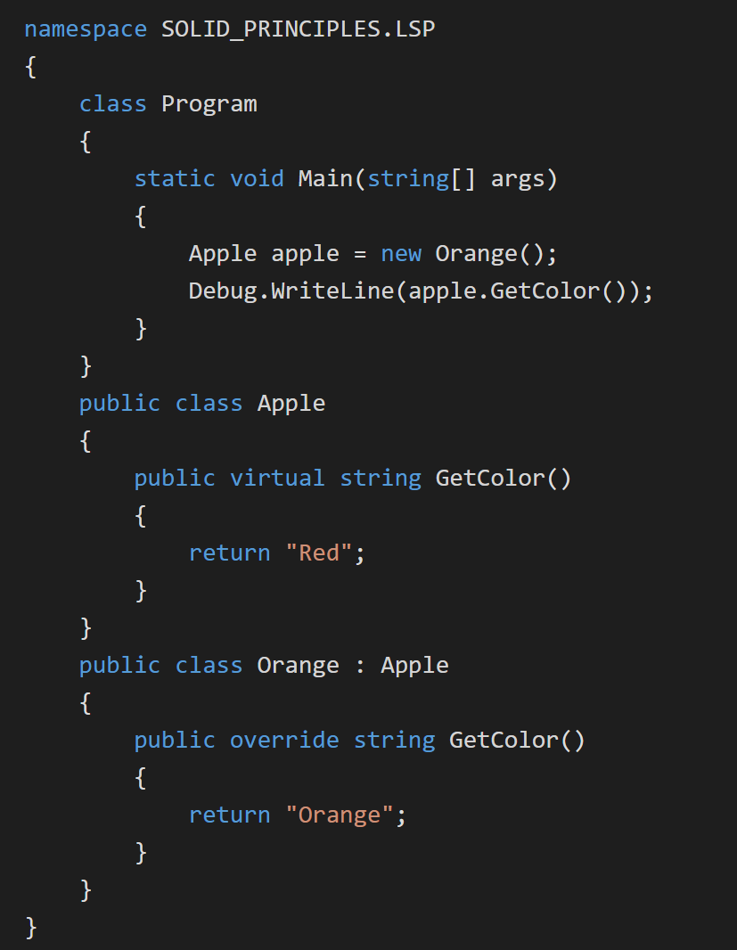
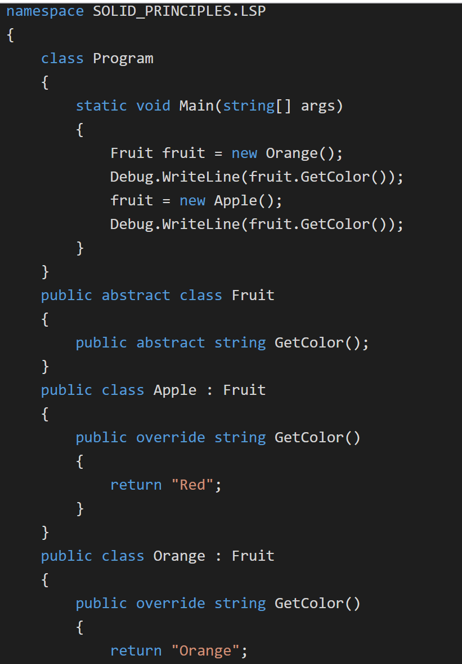
L: Liskov substitution principle
Objects in a program should be replaceable with instances of their subtypes without altering the correctness of that program

Slide 8
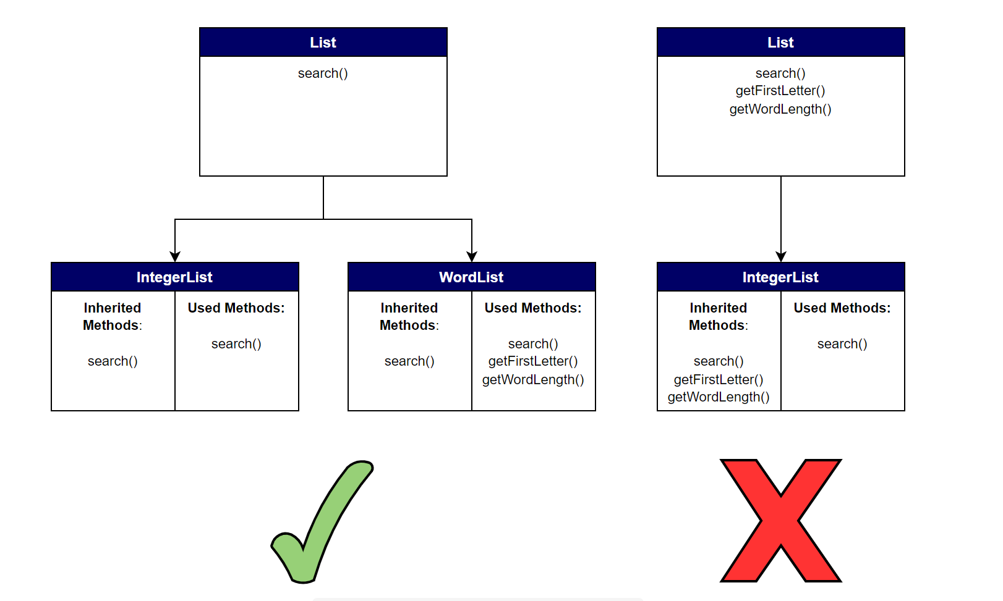
I: Interface segregation principle
Many client-specific interfaces are better than one general-purpose interface

Slide 9
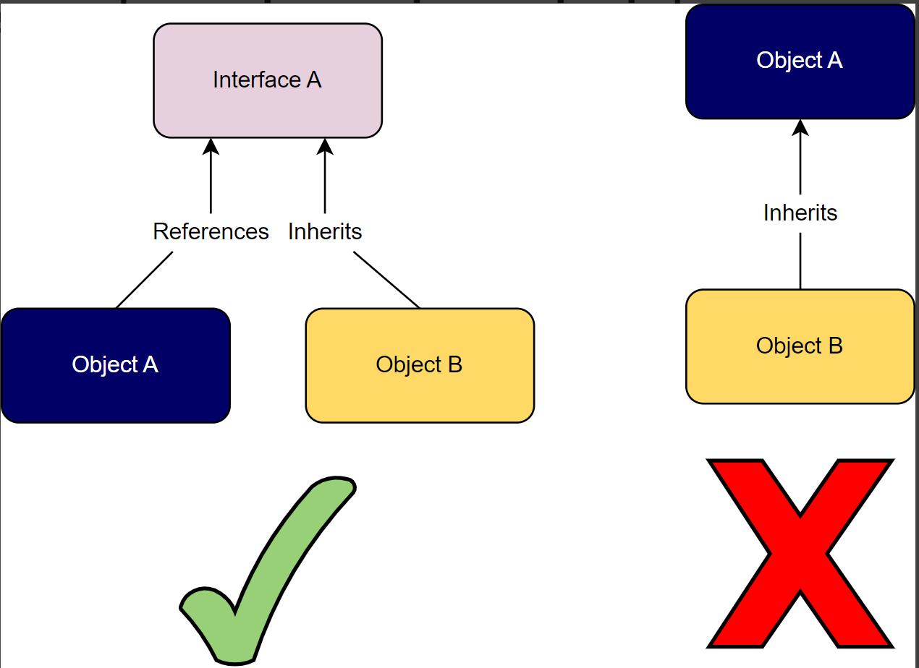
D: Dependency inversion principle
One should depend upon abstractions, [not] concretions
High-level modules should not depend on low-level modules. Instead, both should depend on abstractions (interfaces)
Abstractions should not depend on details. Details (like concrete implementations) should depend on abstractions.

Slide 10
What is Design Pattern
A reusable solution to common software design problems
Why?
More flexible,
Reusable
Maintainable

Slide 11
Categories
Creational
Structural
Behavioral

Slide 12
Creational Design Pattern
Factory Method
Abstract Factory
Builder
Prototype
Singleton

Slide 13
Structural Design Patterns
Adapter
Bridge
Composite
Decorator
Façade
Flyweight
Proxy

Slide 14
Behavioral Design Patterns
Chain of Responsibility
Command
Interpreter
Iterator
Mediator
Memento
Observer
State
Strategy
Visitor
Template Method

Slide 15
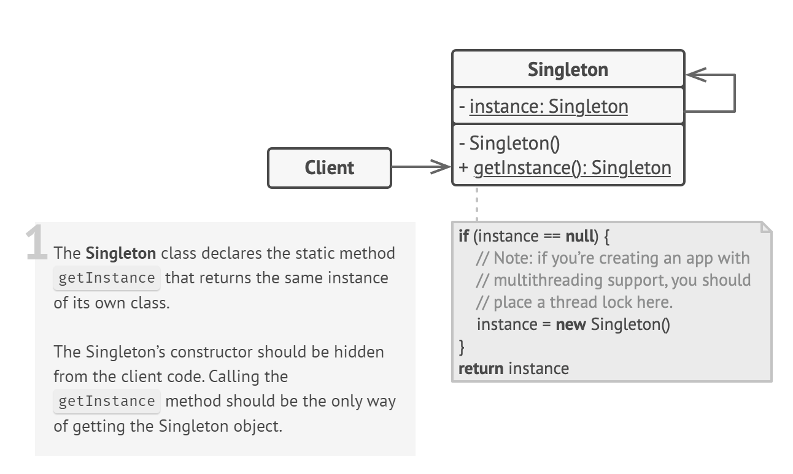
Singleton design pattern
A class has only one instance, while providing a global access point to this instance
Ensure that a class has just a single instance.
Provide a global access point to that instance

Slide 16
Example of singleton
Public sealed class Database{
private static Database instance
private Database() {}
public static method getInstance()
if (instance == null)
instance = new Database()
return instance
public void query(sql)
// For instance, all database queries of an app go
// through this method. Therefore, you can place
// throttling or caching logic here.
// ...
class Application is
void main() is
Database foo = Database.getInstance()
foo.query("SELECT ...")
// ...
Database bar = Database.getInstance()
bar.query("SELECT ...")
// The variable `bar` will contain the same object as
// the variable `foo`.

